Slide 1
Midterm 1 Review
2/13/19

Slide 2
Coming up…
Lab Assignment 4 due tomorrow
Midterm 1 Monday 2/18
Feedback + Help
Problem Set 2 returned by Saturday morning.
Weekend Office Hours: Saturday 2pm-4pm (Lavonne, Old Chem 203B)

Slide 3
Midterm 1
Material Covered:
Units 1-3.2
What to bring:
Cheat sheet
1 page (8.5’’ by 11’’)
Front/back ok
CAN be typed
Calculator (no phones)
Provided:
Z-tables
Exam
4 written questions (like AEs)
5 T/F
10 MC
1

Slide 4
Midterm 1 Review Suggestions
Short answer review:
Make sure you understand how to do the application exercises.
Review Problem Sets (graded)
Short answer practice:
Practice test
Suggested practice problems in the book
1

Slide 5
Final Review Suggestions
Concept review:
Lecture slides (has material not in the videos/book)
Video notes
Readiness Assessments+Performance Assessments
Why are all the other options wrong?
What to think about (among other things):
Interpretations of analyses (WORDING IS IMPORTANT)
Conclusions we would make (WORDING IS IMPORTANT)
Equations
Know exact definitions
FOCUS ON THE WHY BEHIND ANALYSES
If there’s an equation/analysis, make sure you know how to put that equation/analysis into words in the context of the problem.
Conditions
Common misconceptions (lecture notes)
What test to use under certain conditions
1

Slide 6
Unit 1 – Data Collection

Slide 7
Clicker question
Researcher would like to sample SAT scores from high schools in a state. Each high school has a diverse student body. They randomly select 12 high schools in the state and collect SAT scores from all students in the selected high schools. What type of sampling is this?
Simple Random Sample
Stratified Sampling
Cluster Sampling
Multistage Sampling

Slide 8
Clicker question
Researcher would like to sample SAT scores from high schools in a state. Each high school has a diverse student body. They randomly select 12 high schools in the state and collect SAT scores from all students in the selected high schools. What type of sampling is this?
Simple Random Sample
Stratified Sampling
Cluster Sampling
Multistage Sampling

Slide 9
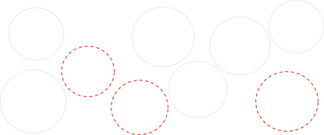
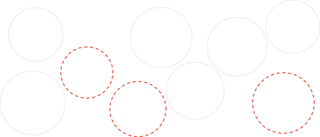
and cluster to make sampling easier
Simple random:
Drawing names from a hat
Cluster: heterogenous clusters Sample all chosen clusters
●
●●●
●●●
●
●
●
●●●
Cluster 2
Cluster 5
●
●
Cluster 9
●●●
●
●
●
● ●
● ●
●
●
Cluster 7
●
●
●
●
●
●
●
●
●
●
●●●
●
●
●
●●● ●
●
●
●
●
●
● ●
● ● ●
●●●
●
● ●
●
● ●
●●
●
●
●
● ●
●
●
●
●
Cluster 3
●●● ●●●●●
●
● ●
●
●
●
●
● ●
●
●
●●
●
●
●
●
●
●
●
●
●
●
●
●●● ●
●
●
●
●
●
●
●●
●
●●
●●
Cluster 8
●
●
●
●
●
Cluster 4
●●●
●
●
●
●
●
●
●
● ●
●
●
● ●
●●● ●●●
●
●
●●●
●
●
●●●
●●
●●●
●●●
●●●
●
●
●
●
●
●● ● ●
●
●●●●
●●
●●● ●●●●●●
●
●
●
●
●
●
●
●●●●
●
●●●
●
●
●●●
●
●●● ●●●
●●
●●●
●
● ● ●
●
●● ●
●
●●●● ●●● ●●
●
●
●
●●
●
●
●
●
●
●
●● ●
● ●●●
●
●
●
●
●●●
● ●
●●●
●●●
●●●
●●●
●●●
●
● ● ● ●
●
●
●●
●●● ●
●
●
●●●
●●● ●
●● ●●●
Cluster 6
●●●
●
●
●
●
●
●
●●●
●
●●●
●
Cluster 1
●●
●
●●●
●●●
●
●
●
●●●
Stratiﬁed: homogenous strata Stratify to control for age group
Multistage: heterogeneous clusters
Random sample in chosen clusters
Stratum 2
Stratum 4
Stratum 6
●●
●
Cluster 2
●●
● ● ●
● ●
●
●
●
●
Cluster 5
●
● ●
Cluster 9
●
●
●●●
Cluster 7
● ● ●
●
● ● ●
●
●
●
●
●
● ● ●
●●
●
Stratum 3
●
● ● ● ●
●
●
● ●
● ● ●
●●●●
● ●●
●
● ●
●
●
●●● ● ● ●
●●● ●●●
●●
●
●
Cluster 3
●
●
●
●● ●●●
●
●
●
●
●
●
● ●
●
●
● ● ●
● ● ● ●
● ●
● ●●
● ● ●
●
●
●
●
●
●
●
●
● ●
●
● ●
●
●
●
●
●
●
● ●
●
●● ●
●
●
●●● ●●●
●
● ●
●
●
Cluster 8
●
● ●
●
●
●
●
●
●
● ●
●
● ●●●
Cluster 4
Stratum 1
●
●
●
●
●
●
●●● ● ●●●
●
●
●
● ●
●
●
● ●
● ●
●
● ●
● ●
●●● ●
●
●
●
●●● ●
●
●●
●
● ●●●
●
● ●
●
●
●
● ● ●
●
●●● ●
●
● ● ●●●
●
●
● ●●● ●
● ●
● ●
● ●
● ●
●●●●
●
●
● ●● ●
●●● ●●●
●
●
●●● ●
●
●
●●●●
●
●
● ●
● ●
●
●
●●●●●●
●
● ●●●●
●●●
●
●●●
●
● ●
Cluster 6
●●
●
● ●
●
Cluster 1
●●●
● ●
●
●●●● ●
●
Stratum 5
● ●●●
3

Slide 10
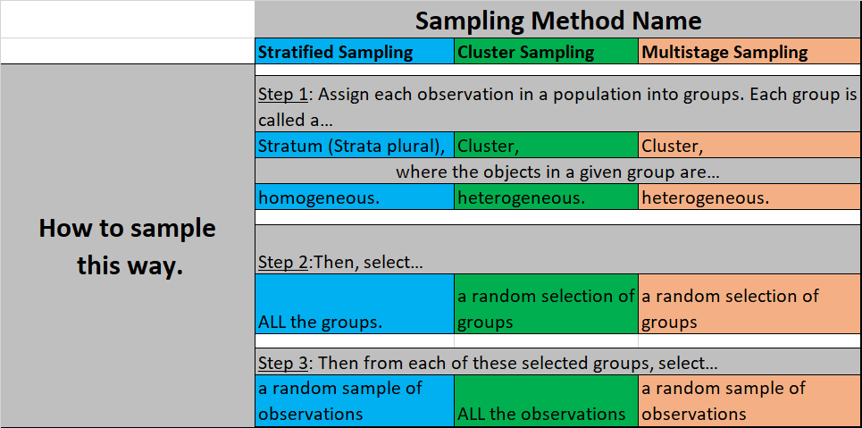
and cluster to make sampling easier

Slide 11
Unit 1 – Data Visualization and Summary Statistics

Slide 12
Unit 1 - Visualizations
What’s an appropriate plot to use for each of the following types of data?
One numerical variable
One categorical variable
Two numerical variables
One categorical variable and one numerical variable
Two categorical variables

Slide 13
Unit 1 - Visualizations
What’s an appropriate plot to use for each of the following types of data?
One numerical variable – boxplot, histogram
One categorical variable – barplot, histogram
Two numerical variables – scatterplot
One categorical variable and one numerical variable – side-by-side boxplots
Two categorical variables – mosaic plot, segmented barplot

Slide 14
Unit 1 – Data Visualization and Summary Statistics
One Numerical Variable

Slide 15
Unit 1 - Visualizations
What four aspects of a numerical variable should we be prepared to discuss?

Slide 16
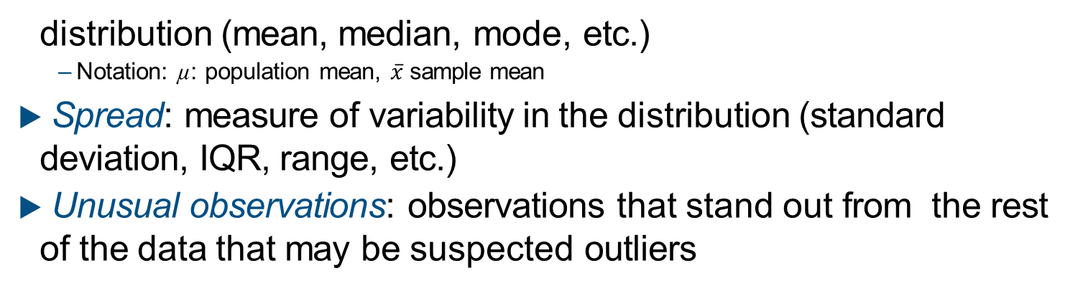
Unit 1 - Visualizations
What four aspects of a numerical variable should we be prepared to discuss?
▶ Shape: skewness, modality
▶ Center: an estimate of a typical observation in the
distribution (mean, median, mode, etc.)
– Notation: µ: population mean, $\overline{x}$ sample mean
▶ Spread: measure of variability in the distribution (standard deviation, IQR, range, etc.)
▶ Unusual observations: observations that stand out from the rest of the data that may be suspected outliers

Slide 17
Clicker question
Which of the following sets of statistics are all robust to outliers?
Variance
Mean, Median
Median, IQR, range
Median, IQR
IQR, Standard deviation

Slide 18
Clicker question
Which of the following sets of statistics are all robust to outliers?
Variance
Mean, Median
Median, IQR, range
Median, IQR
IQR, Standard deviation

Slide 19
Robust statistics
▶ Mean and standard deviation are easily affected by extreme observations since the value of each data point contributes to their calculation.
▶ Median and IQR are more robust to outliers.
▶ Therefore we choose median & IQR (over mean&SD) when describing skewed distributions.
▶ We choose mean & SD when describing symmetric distributions, as they are more useful in using mathematical theory to make inferences.
13

Slide 20
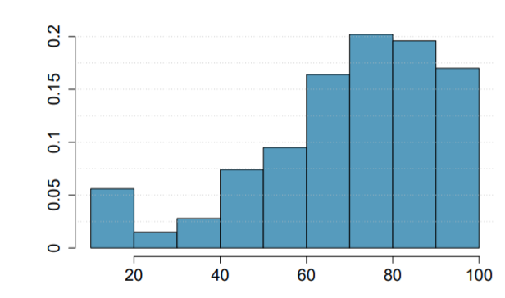
Clicker question
Which of the following is false?
The box plot would have outliers only on the lower end.
The median is between 70 and 80.
More than 25% of the data is above 90.
More than 50% of the data have positive Z scores.
The mean is likely to be smaller than the median.

Slide 21
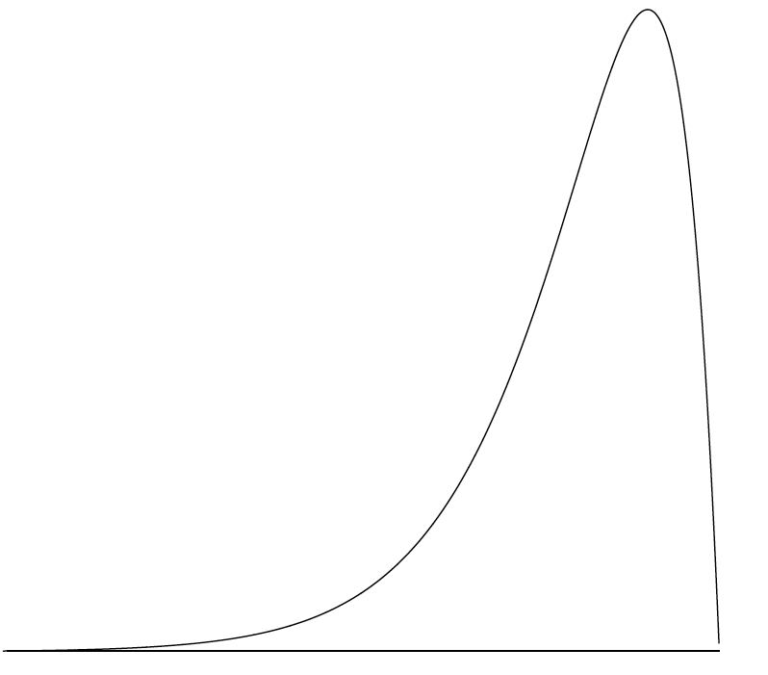
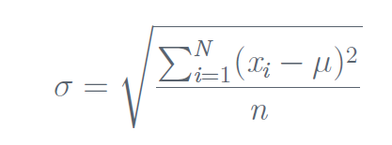
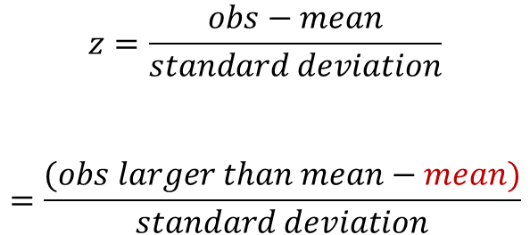
$$z=\frac{obs−mean}{standard deviation}$$
$$=\frac{(obs larger than mean−mean)}{standard deviation}$$
positive
NEVER negative
mean
median

Slide 22
Clicker question
Which of the following is false?
The box plot would have outliers only on the lower end.
The median is between 70 and 80.
More than 25% of the data is above 90.
More than 50% of the data have positive Z scores. (MEAN SMALLER THAN MEDIAN)
The mean is likely to be smaller than the median. (LEFT SKEWED)

Slide 23
Clicker question
Which of the following is false?
The box plot would have outliers only on the lower end.
The median is between 70 and 80.
More than 25% of the data is above 90.
More than 50% of the data have positive Z scores.
The mean is likely to be smaller than the median.
Q1≈60 Median ≈75 Q3≈85

Slide 24
Clicker question
Which of the following is false?
The box plot would have outliers only on the lower end.
The median is between 70 and 80.
More than 25% of the data is above 90.
More than 50% of the data have positive Z scores.
The mean is likely to be smaller than the median.
IQR=Q3-Q1 ≈ 25
Lower Fence
Q1-1.5IQR
Upper Fence
Q3+1.5IQR
Q1≈60 Median ≈75 Q3≈85

Slide 25
Clicker question
Which of the following is false?
The box plot would have outliers only on the lower end.
The median is between 70 and 80.
More than 25% of the data is above 90.
More than 50% of the data have positive Z scores.
The mean is likely to be smaller than the median.
IQR=Q3-Q1 ≈ 25
Lower Fence
Q1-1.5IQR
Upper Fence
Q3+1.5IQR
Q1≈60 Median ≈75 Q3≈85
outliers
NO OUTLIERS!

Slide 26
Unit 1 – Data Visualization and Summary Statistics
Two Categorical Variables

Slide 27
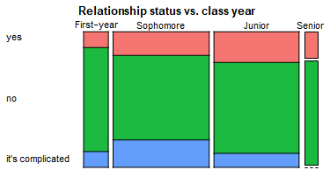
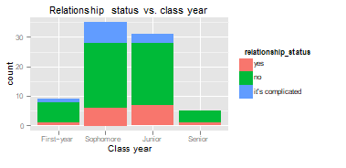
Clicker question
Is a mosaic plot or a segmented bar plot better at determining if two categorical variables are independent/not-associated or dependent/assoc?
Mosaic plot
Segmented bar plot

Slide 28
Clicker question
Is a mosaic plot or a segmented bar plot better at determining if two categorical variables are independent/not-associated or dependent/assoc?
Mosaic plot
Segmented bar plot

Slide 29
Clicker question
What probabilities would you need to calculate to show that being in a relationship is associated with class year?
P(yes|first-year)≠ P(no|first-year) ≠ P(it’s complicated|first-year)
P(yes|first-year)≠ P(yes|sophomore) ≠ P(yes|junior) ≠ P(yes|senior)
P(no|first-year)≠ P(no|sophomore) ≠ P(no|junior) ≠ P(no|senior)
Show (b) and (c)

Slide 30
Clicker question
What probabilities would you need to calculate to show that being in a relationship is associated with class year?
P(yes|first-year)≠ P(no|first-year) ≠ P(it’s complicated|first-year)
P(yes|first-year)≠ P(yes|sophomore) ≠ P(yes|junior) ≠ P(yes|senior)
P(no|first-year)≠ P(no|sophomore) ≠ P(no|junior) ≠ P(no|senior)
Show (b) and (c)

Slide 31
Unit 1 – Making Inferences
Types of Inferences you Can Make and When You Can Make Them

Slide 32
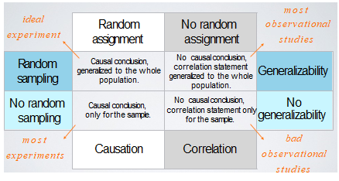
Types of Inferences you Can Make and When You Can Make Them

Slide 33
Unit 1 – Making Inferences
...with Randomization Testing

Slide 34
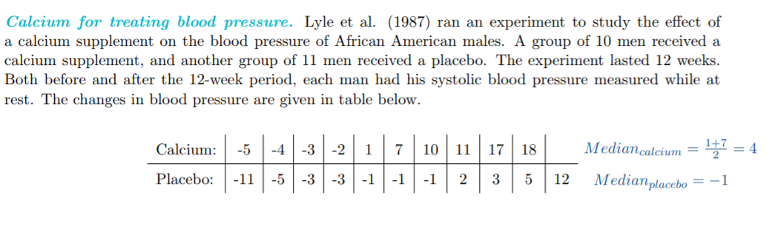

Slide 35
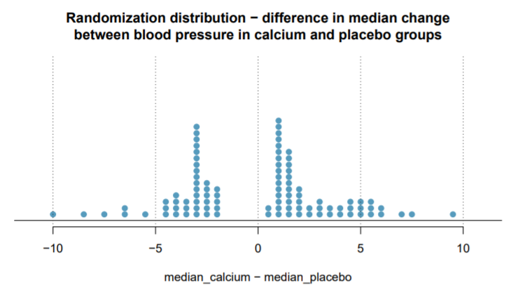

Clicker question
We would like to test if the median change in blood pressure of the calcium group is greater than that of the placebo group. Below is a randomization distribution created for this research question (100 simulations), what is the p-value for the randomization test?
Sample Medians of Two Groups
$${\hat{median}}_{calc}=4$$
$${\hat{median}}_{placebo}=−1$$
11/100
17/100
17/200
8/100
6/100

Slide 36
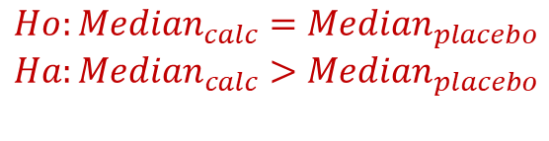

Clicker question
We would like to test if the median change in blood pressure of the calcium group is greater than that of the placebo group. Below is a randomization distribution created for this research question (100 simulations), what is the p-value for the randomization test?
Sample Medians of Two Groups
Hypotheses
$$Ho:{Median}_{calc}={Median}_{placebo}$$
$$Ha:{Median}_{calc}>{Median}_{placebo}$$
$${\hat{median}}_{calc}=4$$
$${\hat{median}}_{placebo}=−1$$
Point Estimate/Sample Statistic
11/100
17/100
17/200
8/100
6/100
$${\hat{median}}_{calc}−{\hat{median}}_{placebo}=5$$
11/100 points are as or more extreme than 5

Slide 37
Clicker question
We would like to test if the median change in blood pressure of the calcium group is different than that of the placebo group. Below is a randomization distribution created for this research question (100 simulations), what is the p-value for the randomization test?
Sample Medians of Two Groups
$${\hat{median}}_{calc}=4$$
$${\hat{median}}_{placebo}=−1$$
11/100
17/100
17/200
8/100
6/100

Slide 38
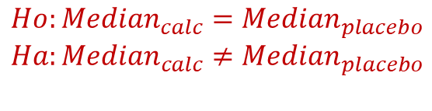
Clicker question
We would like to test if the median change in blood pressure of the calcium group is different than that of the placebo group. Below is a randomization distribution created for this research question (100 simulations), what is the p-value randomization test?
Sample Medians of Two Groups
Hypotheses
$$Ho:{Median}_{calc}={Median}_{placebo}$$
$$Ha:{Median}_{calc}≠{Median}_{placebo}$$
$${\hat{median}}_{calc}=4$$
$${\hat{median}}_{placebo}=−1$$
Point Estimate/Sample Statistic
11/100
17/100
17/200
8/100
6/100
$${\hat{median}}_{calc}−{\hat{median}}_{placebo}=5$$
17/100 points are as or more extreme than 5 or -5.

Slide 39
Unit 1 – Making Inferences
...what is the definition of a p-value?
…what conclusions can we make?

Slide 40
Definition
p-value = P(a sample statistic/data that is as “extreme” or “more extreme” than the one observed |null hypothesis is true)

Slide 41
Conclusions
p-value < significance level (commonly 0.05)
Reject the null hypothesis. There exists sufficient evidence to suggest the alternative hypothesis.
p-value ≥ significance level (commonly 0.05)
Fail to reject the null hypothesis. There does not exist sufficient evidence to suggest the alternative hypothesis.

Slide 42
Unit 2 – General Probability Properties

Slide 43
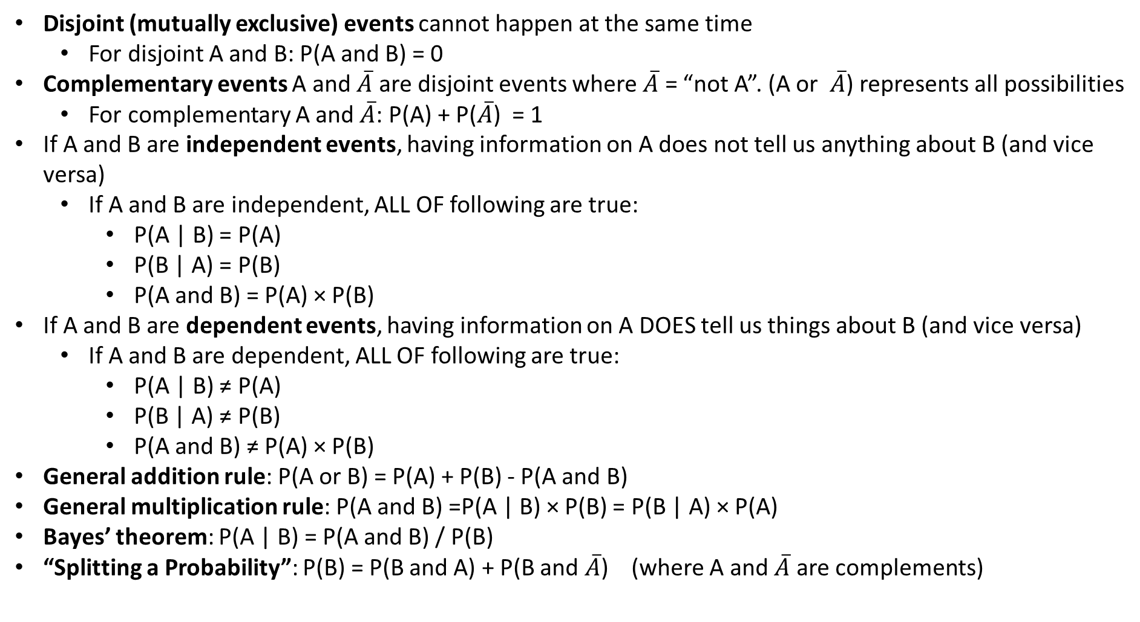
General Probability Rules
Disjoint (mutually exclusive) events cannot happen at the same time
For disjoint A and B: P(A and B) = 0
Complementary events A and $\overline{A}$ are disjoint events where $\overline{A}$ = “not A”. (A or $\overline{A}$) represents all possibilities
For complementary A and $\overline{A}$: P(A) + P($\overline{A}$) = 1
If A and B are independent events, having information on A does not tell us anything about B (and vice versa)
If A and B are independent, ALL OF following are true:
P(A | B) = P(A)
P(B | A) = P(B)
P(A and B) = P(A) × P(B)
If A and B are dependent events, having information on A DOES tell us things about B (and vice versa)
If A and B are dependent, ALL OF following are true:
P(A | B) ≠ P(A)
P(B | A) ≠ P(B)
P(A and B) ≠ P(A) × P(B)
General addition rule: P(A or B) = P(A) + P(B) - P(A and B)
General multiplication rule: P(A and B) =P(A | B) × P(B) = P(B | A) × P(A)
Bayes’ theorem: P(A | B) = P(A and B) / P(B)
“Splitting a Probability”: P(B) = P(B and A) + P(B and $\overline{A}$) (where A and $\overline{A}$ are complements)

Slide 44
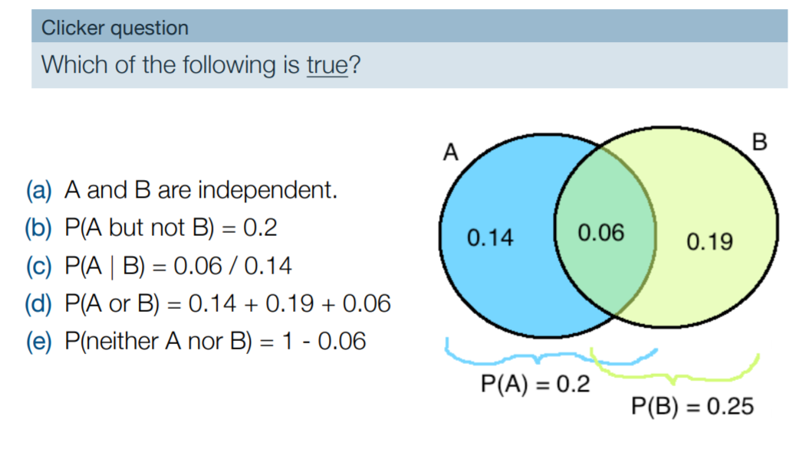
General Probability Rules

Slide 45
General Probability Rules

Slide 46
Unit 2 – Binomial and Normal Probabilities -How do we know which equations to use?

Slide 47
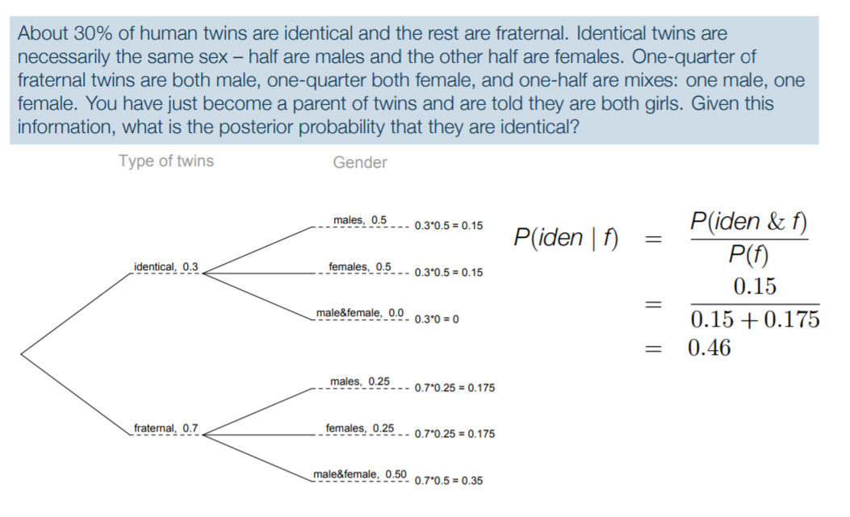
Unit 2 – Binomial and Normal Probabilities -How do we know which equations to use?
Clicker question
Which of the following could be the correct input for a probability tree?
0.25
0.70
0.70
0.25
0.30
0.25
0.50
0.30

Slide 48
Unit 2 – Binomial and Normal Probabilities -How do we know which equations to use?
Clicker question
Which of the following could be the correct input for a probability tree?
0.25
0.25
0.70
0.70
0.70
0.25
0.30
0.25
0.50
0.30

Slide 49

Unit 2 – Binomial and Normal Probabilities -How do we know which equations to use?
Clicker question
What is P(iden|f)?
$\frac{0.3}{0.5+0.25}$
$\frac{0.15}{0.15+0.175}$
$\frac{0.15}{0.175}$

Slide 50

Unit 2 – Binomial and Normal Probabilities -How do we know which equations to use?
Clicker question
What is P(iden|f)?
$\frac{0.3}{0.5+0.25}$
$\frac{0.15}{0.15+0.175}$
$\frac{0.15}{0.175}$

Slide 51
Unit 2 – Binomial and Normal Probabilities -How do we know which equations to use?

Slide 52
Clicker question
What would you need to do solve this problem?
Suppose it is known that the probability a STA101 student had a horse growing up is 0.09. We collected a random sample of 100 STA101 students and asked them if they had a horse growing up. What’s the probability that at least 3 students had a horse growing up?
Calculate exactly one binomial expression.
Calculate multiple binomial expressions (and/or add/subtract/do other things with them).
Approximate a binomial distribution with a normal distribution (but don’t check/show any conditions before you do this.)
Approximate a binomial distribution with a normal distribution (but DO check/show conditions before you do this.)
NONE OF THE ABOVE (Use other probability equations that aren’t specific to binomial and normal distributions).

Slide 53
Clicker question
What would you need to do solve this problem?
Suppose it is known that the probability a STA101 student had a horse growing up is 0.09. We collected a random sample of 100 STA101 students and asked them if they had a horse growing up. What’s the probability that at least 3 students had a horse growing up?
Calculate exactly one binomial expression.
Calculate multiple binomial expressions (and/or add/subtract/do other things with them).
Approximate a binomial distribution with a normal distribution (but don’t check/show any conditions before you do this.)
Approximate a binomial distribution with a normal distribution (but DO check/show conditions before you do this.)
NONE OF THE ABOVE (Use other probability equations that aren’t specific to binomial and normal distributions).

Slide 54

Clicker question
What would you need to do solve this problem?
Suppose it is known that the probability a STA101 student had a horse growing up is 0.09. We collected a random sample of 100 STA101 students and asked them if they had a horse growing up. What’s the probability that at least 3 students had a horse growing up?
Binomial distribution is appropriate because:
n=100 trials (and asking for the probability of exactly/at least/at most k=3 of these trials are a success=horse)
each trial has probability 0.09
independent trials
only two possibilities (horse/no horse)
Step 1: If X = # of students out of random sample of 100 STA101 student that had a horse, show that
$X\sim Bin(n=100, p=0.09$)
Step 2: Calculate multiple binomial expressions (and/or add/subtract/do other things with them) to find P(X ≥ 3).

Slide 55
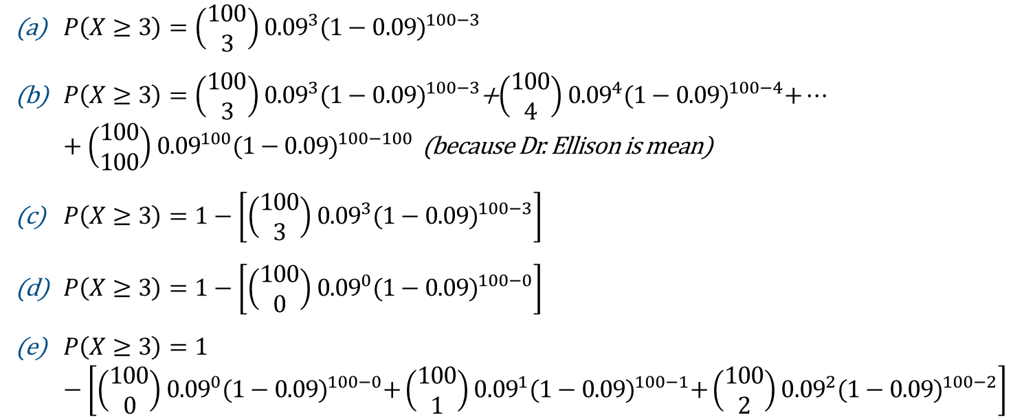
Clicker question
What would you need to do solve this problem?
Suppose it is known that the probability a STA101 student had a horse growing up is 0.09. We collected a random sample of 100 STA101 students and asked them if they had at least one horse growing up. What’s the probability that at least 3 students had a horse growing up?
Step 2: Calculate multiple binomial expressions (and add/subtract/do other things with them) to find P(X ≥ 3).
$P\left(X≥3\right)=\left(\begin{matrix}100 \\ 3\end{matrix}\right){0.09}^{3}{(1−0.09)}^{100−3}$
$P\left(X≥3\right)=\left(\begin{matrix}100 \\ 3\end{matrix}\right){0.09}^{3}{(1−0.09)}^{100−3}$+$\left(\begin{matrix}100 \\ 4\end{matrix}\right){0.09}^{4}{(1−0.09)}^{100−4}+…+\left(\begin{matrix}100 \\ 100\end{matrix}\right){0.09}^{100}{(1−0.09)}^{100−100}$ (because Dr. Ellison is mean)
$P\left(X≥3\right)=1−\left[\left(\begin{matrix}100 \\ 3\end{matrix}\right){0.09}^{3}{(1−0.09)}^{100−3}\right]$
$P\left(X≥3\right)=1−\left[\left(\begin{matrix}100 \\ 0\end{matrix}\right){0.09}^{0}{(1−0.09)}^{100−0}\right]$
$P\left(X≥3\right)=1−\left[\left(\begin{matrix}100 \\ 0\end{matrix}\right){0.09}^{0}{(1−0.09)}^{100−0}+\left(\begin{matrix}100 \\ 1\end{matrix}\right){0.09}^{1}{(1−0.09)}^{100−1}+\left(\begin{matrix}100 \\ 2\end{matrix}\right){0.09}^{2}{(1−0.09)}^{100−2}\right]$

Slide 56
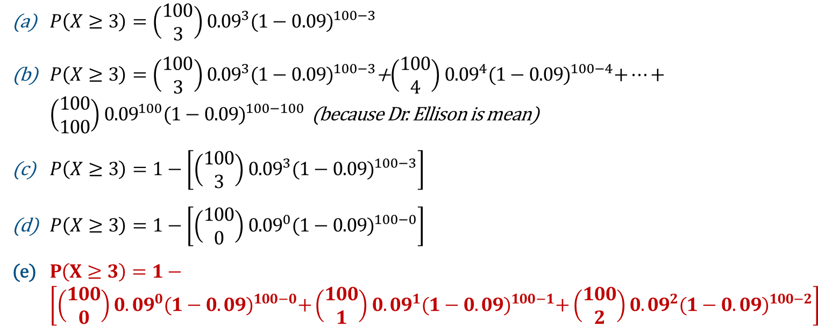
Clicker question
What would you need to do solve this problem?
Suppose it is known that the probability a STA101 student had a horse growing up is 0.09. We collected a random sample of 100 STA101 students and asked them if they had at least one horse growing up. What’s the probability that at least 3 students had a horse growing up?
Step 2: Calculate multiple binomial expressions (and add/subtract/do other things with them) to find P(X ≥ 3).
$P\left(X≥3\right)=\left(\begin{matrix}100 \\ 3\end{matrix}\right){0.09}^{3}{(1−0.09)}^{100−3}$
$P\left(X≥3\right)=\left(\begin{matrix}100 \\ 3\end{matrix}\right){0.09}^{3}{(1−0.09)}^{100−3}$+$\left(\begin{matrix}100 \\ 4\end{matrix}\right){0.09}^{4}{(1−0.09)}^{100−4}+…+\left(\begin{matrix}100 \\ 100\end{matrix}\right){0.09}^{100}{(1−0.09)}^{100−100}$ (because Dr. Ellison is mean)
$P\left(X≥3\right)=1−\left[\left(\begin{matrix}100 \\ 3\end{matrix}\right){0.09}^{3}{(1−0.09)}^{100−3}\right]$
$P\left(X≥3\right)=1−\left[\left(\begin{matrix}100 \\ 0\end{matrix}\right){0.09}^{0}{(1−0.09)}^{100−0}\right]$
$P\left(X≥3\right)=1−\left[\left(\begin{matrix}100 \\ 0\end{matrix}\right){0.09}^{0}{(1−0.09)}^{100−0}+\left(\begin{matrix}100 \\ 1\end{matrix}\right){0.09}^{1}{(1−0.09)}^{100−1}+\left(\begin{matrix}100 \\ 2\end{matrix}\right){0.09}^{2}{(1−0.09)}^{100−2}\right]$

Slide 57
Clicker question
What would you need to do solve this problem?
Suppose it is known that the probability a STA101 student had a horse growing up is 0.09. We collected a random sample of 100 STA101 students and asked them if they had at least one horse growing up. What’s the probability that 3 students had a horse growing up?
Calculate exactly one binomial expression.
Calculate multiple binomial expressions (and add/subtract/do other things with them).
Approximate a binomial distribution with a normal distribution (but don’t check/show any conditions before you do this.)
Approximate a binomial distribution with a normal distribution (but DO check/show conditions before you do this.)
NONE OF THE ABOVE (Use other probability equations that aren’t specific to binomial and normal distributions).

Slide 58
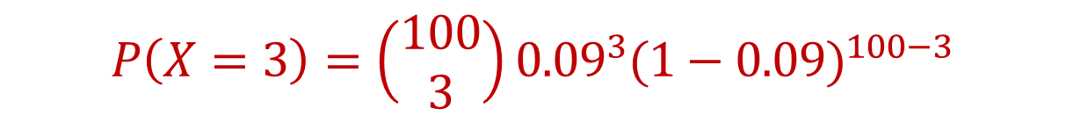
Clicker question
What would you need to do solve this problem?
Suppose it is known that the probability a STA101 student had a horse growing up is 0.09. We collected a random sample of 100 STA101 students and asked them if they had at least one horse growing up. What’s the probability that 3 students had a horse growing up?
Calculate exactly one binomial expression.
Calculate multiple binomial expressions (and add/subtract/do other things with them).
Approximate a binomial distribution with a normal distribution (but don’t check/show any conditions before you do this.)
Approximate a binomial distribution with a normal distribution (but DO check/show conditions before you do this.)
NONE OF THE ABOVE (Use other probability equations that aren’t specific to binomial and normal distributions).
$$P\left(X=3\right)=\left(\begin{matrix}100 \\ 3\end{matrix}\right){0.09}^{3}{(1−0.09)}^{100−3}$$

Slide 59
Clicker question
What would you need to do solve this problem?
Suppose it is known that the probability a STA101 student had a horse growing up is 0.09. We collected a random sample of 100 STA101 students and asked them if they had at least one horse growing up. What’s the probability that the first 5 we ask had a horse, and then the last 95 we ask did not have a horse?
Calculate exactly one binomial expression.
Calculate multiple binomial expressions (and add/subtract/do other things with them).
Approximate a binomial distribution with a normal distribution (but don’t check/show any conditions before you do this.)
Approximate a binomial distribution with a normal distribution (but DO check/show conditions before you do this.)
NONE OF THE ABOVE (Use other probability equations that aren’t specific to binomial and normal distributions).

Slide 60
Clicker question
What would you need to do solve this problem?
Suppose it is known that the probability a STA101 student had a horse growing up is 0.09. We collected a random sample of 100 STA101 students and asked them if they had at least one horse growing up. What’s the probability that the first 5 we ask had a horse, and then the last 95 we ask did not have a horse?
Calculate exactly one binomial expression.
Calculate multiple binomial expressions (and add/subtract/do other things with them).
Approximate a binomial distribution with a normal distribution (but don’t check/show any conditions before you do this.)
Approximate a binomial distribution with a normal distribution (but DO check/show conditions before you do this.)
NONE OF THE ABOVE (Use other probability equations that aren’t specific to binomial and normal distributions).

Slide 61

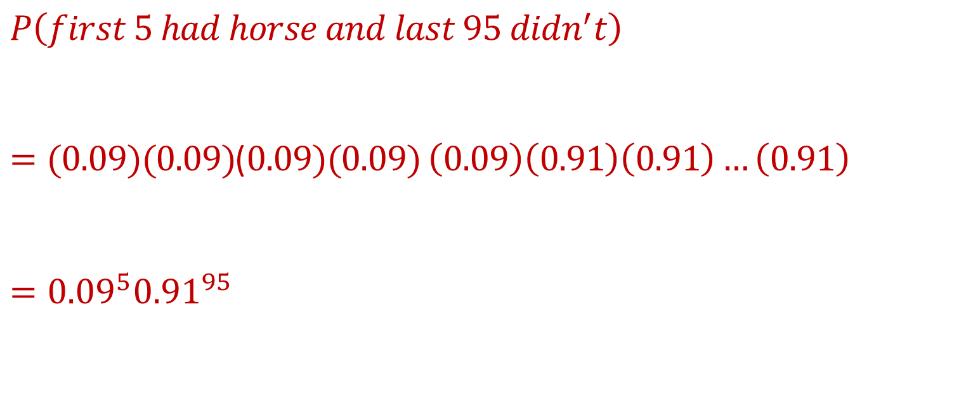

Clicker question
What would you need to do solve this problem?
Suppose it is known that the probability a STA101 student had a horse growing up is 0.09. We collected a random sample of 100 STA101 students and asked them if they had at least one horse growing up. What’s the probability that the first 5 we ask had a horse, and then the last 95 we ask did not have a horse?
NONE OF THE ABOVE (Use other probability equations that aren’t specific to binomial and normal distributions).
$$P\left(first 5 had horse and last 95 didn^{′}t\right)$$
$=(0.09)(0.09)$($0.09)(0.09)$ $\left(0.09\right)\left(0.91\right)\left(0.91\right)…\left(0.91\right)$
$$={0.09}^{5}{0.91}^{95}$$
$$5$$
$$95$$

Slide 62
Clicker question
What would you need to do solve this problem?
Suppose it is known that the probability a STA101 student had a horse growing up is 0.09 and the probability that they had a dog is 0.62 and the probability that they had a dog and a horse is 0.05. What is the probability a student had a dog or a horse growing up?
Calculate exactly one binomial expression.
Calculate multiple binomial expressions (and add/subtract/do other things with them).
Approximate a binomial distribution with a normal distribution (but don’t check/show any conditions before you do this.)
Approximate a binomial distribution with a normal distribution (but DO check/show conditions before you do this.)
NONE OF THE ABOVE (Use other probability equations that aren’t specific to binomial and normal distributions).

Slide 63
Clicker question
What would you need to do solve this problem?
Suppose it is known that the probability a STA101 student had a horse growing up is 0.09 and the probability that they had a dog is 0.62 and the probability that they had a dog and a horse is 0.05. What is the probability a student had a dog or a horse growing up?
Calculate exactly one binomial expression.
Calculate multiple binomial expressions (and add/subtract/do other things with them).
Approximate a binomial distribution with a normal distribution (but don’t check/show any conditions before you do this.)
Approximate a binomial distribution with a normal distribution (but DO check/show conditions before you do this.)
NONE OF THE ABOVE (Use other probability equations that aren’t specific to binomial and normal distributions).
$$P\left(dog or horse\right)=\left(0.09\right)+\left(0.62\right)−(0.05)$$

Slide 64
Clicker question
What would you need to do solve this problem?
Suppose it is known that the probability a STA101 student had a horse growing up is 0.09. We collected a random sample of 200 STA101 students and asked them if they had at least one horse growing up. What’s the probability that at least 50 students had a horse growing up?
Calculate exactly one binomial expression.
Calculate multiple binomial expressions (and add/subtract/do other things with them).
Approximate a binomial distribution with a normal distribution (but don’t check/show any conditions before you do this.)
Approximate a binomial distribution with a normal distribution (but DO check/show conditions before you do this.)
NONE OF THE ABOVE (Use other probability equations that aren’t specific to binomial and normal distributions).

Slide 65
Clicker question
What would you need to do solve this problem?
Suppose it is known that the probability a STA101 student had a horse growing up is 0.09. We collected a random sample of 200 STA101 students and asked them if they had at least one horse growing up. What’s the probability that at least 50 students had a horse growing up?
Calculate exactly one binomial expression.
Calculate multiple binomial expressions (and add/subtract/do other things with them).
Approximate a binomial distribution with a normal distribution (but don’t check/show any conditions before you do this.)
Approximate a binomial distribution with a normal distribution (but DO check/show conditions before you do this.)
NONE OF THE ABOVE (Use other probability equations that aren’t specific to binomial and normal distributions).

Slide 66


Clicker question
What would you need to do solve this problem?
Suppose it is known that the probability a STA101 student had a horse growing up is 0.09. We collected a random sample of 200 STA101 students and asked them if they had at least one horse growing up. What’s the probability that at least 50 students had a horse growing up?
Step 1: X = # of students out of random sample of 200 STA101 students that had a horse.
Show that
✓n=independent trials
✓Each trial is independent
✓Each trial is success (had a horse) or a failure (didn’t have a horse)
✓Probability each trial is a success is 0.09
Step 2: Show that
Step 3:
$X\sim Bin(n=200, p=0.09$)
$$X\sim N(μ=np, σ=\sqrt{np\left(1−p\right)})$$
SF Conditions Hold:
✓200(.09)≥10
✓200(1-.09)≥10
Use Z-tables
$$P\left(X≥50\right)=P\left(Z≥\frac{50−\left(np\right)}{\sqrt{np(1−p)}}\right)=P\left(Z≥\frac{50−\left(200∙0.09\right)}{\sqrt{200∙0.09∙\left(1−0.09\right)}}\right)=P(Z≥7.9)≈0$$

Slide 67
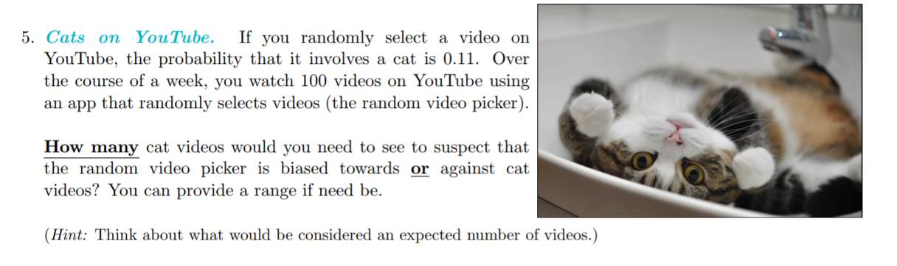

Slide 68
What does “biased toward/against” mean?
Biased towards cat videos = unusually hight # of cat videos.
Biased against cat videos = unusually low # of cat videos.

Slide 69

What does “biased toward/against” mean?
Biased towards cat videos = unusually high # of cat videos.
Biased against cat videos = unusually low # of cat videos.
Let X = number of cat videos you watch.
IF $X\sim N(μ=?, σ=?)$, then we can say:
$μ+2σ$is a unusually high # of cat videos
$μ−2σ$is a unusually low # of cat videos

Slide 70
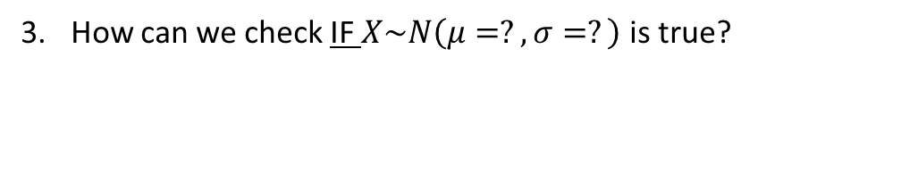
What does “biased toward/against” mean?
Biased towards cat videos = unusually high # of cat videos.
Biased against cat videos = unusually low # of cat videos.
Let X = number of cat videos you watch.
IF $X\sim N(μ=?, σ=?)$, then we can say:
$μ+2σ$is a unusually high # of cat videos
$μ−2σ$is a unusually low # of cat videos
How can we check IF $X\sim N\left(μ=?, σ=?\right)$ is true?

Slide 71

What does “biased toward/against” mean?
Biased towards cat videos = unusually high # of cat videos.
Biased against cat videos = unusually low # of cat videos.
Let X = number of cat videos you watch.
IF $X\sim N(μ=?, σ=?)$, then we can say:
$μ+2σ$is a unusually high # of cat videos
$μ−2σ$is a unusually low # of cat videos
How can we check IF $X\sim N\left(μ=?, σ=?\right)$ is true?
IF:
$X\sim Bin(n=?, p=?)$ AND
np≥10 and n(1-p)≥10
THEN it is the case that
$X\sim N(μ=np, σ=\sqrt{np(1−p)})$,
See board!

Slide 72
Unit 3 – Properties of Sampling Distributions and the Central Limit Theorem

Slide 73
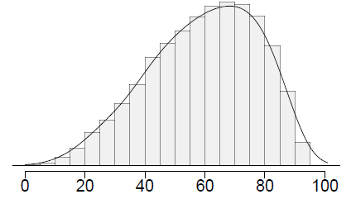
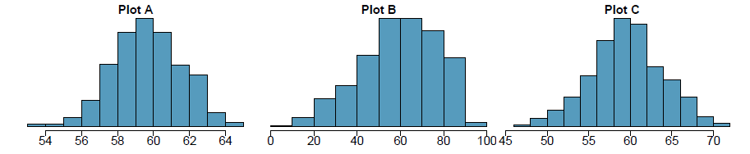
Clicker question
Four plots: Determine which plot (A, B, or C) is which.
At top: distribution for a population (µ = 60, σ = 18),
a single random sample of 500 observations from this population,
a distribution of 500 sample means from random samples with size 18,
a distribution of 500 sample means from random samples with size 81.
Four plots: Determine which plot (A, B, or C) is which.
At top: distribution for a population (µ = 60, σ = 18),
a single random sample of 500 observations from this population,
a distribution of 500 sample means from random samples with size 18,
a distribution of 500 sample means from random samples with size 81.
(a) (2) - B; (3) - A; (4) - C
(b) (2) - A; (3) - B; (4) - C
(c) (2) - C; (3) - A; (4) - D
(d) (2) - B; (3) - C; (4) - A
17

Slide 74
Clicker question
Four plots: Determine which plot (A, B, or C) is which.
At top: distribution for a population (µ = 60, σ = 18),
a single random sample of 500 observations from this population,
a distribution of 500 sample means from random samples with size 18,
a distribution of 500 sample means from random samples with size 81.
(a) (2) - B; (3) - A; (4) - C
(b) (2) - A; (3) - B; (4) - C
(c) (2) - C; (3) - A; (4) - D
(d) (2) - B; (3) - C; (4) - A
17

Slide 75
A housing survey was conducted to determine the price of a typical home in Topanga, CA. The mean price of a house was roughly $1.3 million with a standard deviation of $300,000. There were no houses listed below $600,000 but a few houses above $3 million.
Would you expect most houses in Topanga to cost more or less than
$1.3 million? Hint: What is most likely the shape of this distribution?
18

Slide 76
A random housing survey was conducted to determine the price of a typical home in Topanga, CA. The mean price of a house was roughly $1.3 million with a standard deviation of $300,000. There were no houses listed below $600,000 but a few houses above $3 million.
Would you expect most houses in Topanga to cost more or less than
$1.3 million? Hint: What is most likely the shape of this distribution?
Since the distribution is probably right skewed, the median would be less than the mean, and a majority of observations would be lower than the mean.
18

Slide 77
A random housing survey was conducted to determine the price of a typical home in Topanga, CA. The mean price of a house was roughly $1.3 million with a standard deviation of $300,000. There were no houses listed below $600,000 but a few houses above $3 million.
Clicker question
Can we estimate the probability that a randomly chosen house in Topanga costs more than $1.4 million using the normal distribution?
yes
no
20

Slide 78
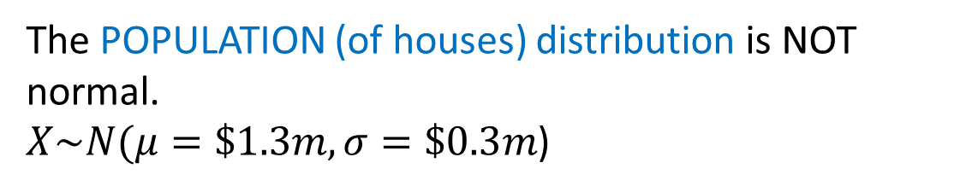
A random housing survey was conducted to determine the price of a typical home in Topanga, CA. The mean price of a house was roughly $1.3 million with a standard deviation of $300,000. There were no houses listed below $600,000 but a few houses above $3 million.
Clicker question
Can we estimate the probability that a randomly chosen house in Topanga costs more than $1.4 million using the normal distribution?
yes
no
The POPULATION (of houses) distribution is NOT normal.
$X\sim N(μ=\$1.3m,σ=\$0.3m$)
20

Slide 79
A random housing survey was conducted to determine the price of a typical home in Topanga, CA. The mean price of a house was roughly $1.3 million with a standard deviation of $300,000. There were no houses listed below $600,000 but a few houses above $3 million.
Clicker question
Can we estimate the probability that the mean of 60 randomly chosen houses in Topanga is more than $1.4 million?
yes
no
20

Slide 80
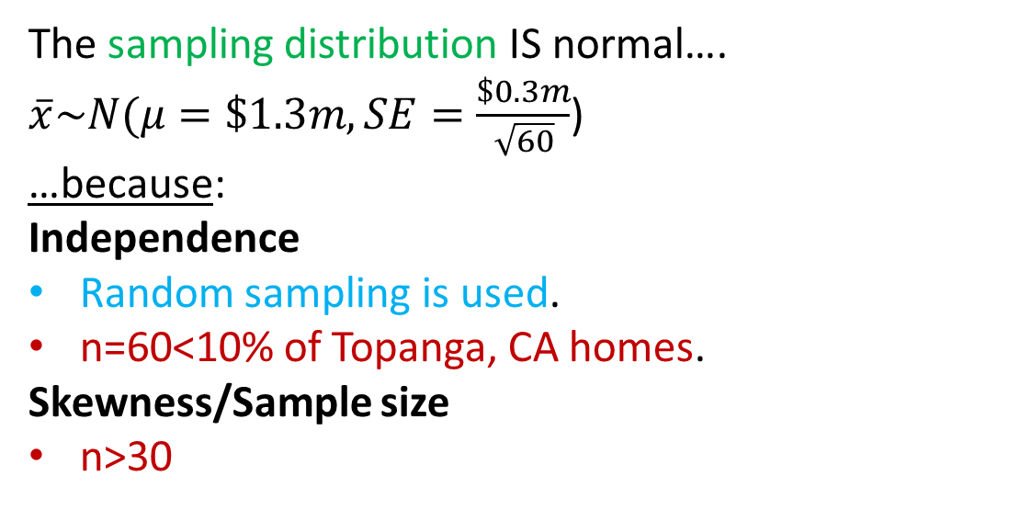
A random housing survey was conducted to determine the price of a typical home in Topanga, CA. The mean price of a house was roughly $1.3 million with a standard deviation of $300,000. There were no houses listed below $600,000 but a few houses above $3 million.
Clicker question
Can we estimate the probability that the mean of 60 randomly chosen houses in Topanga is more than $1.4 million?
The sampling distribution IS normal….
$\overline{x}\sim N(μ=\$1.3m,SE=\frac{\$0.3m}{\sqrt{60}}$)
…because:
Independence
Random sampling is used.
n=60<10% of Topanga, CA homes.
Skewness/Sample size
n>30
yes
no
20

Slide 81

A housing survey was conducted to determine the price of a typical home in Topanga, CA. The mean price of a house was roughly $1.3 million with a standard deviation of $300,000. There were no houses listed below $600,000 but a few houses above $3 million.
What is the probability that the mean of 60 randomly chosen houses in Topanga is more than $1.4 million?
$$P(\overline{X}>1.4 mil)$$
21

Slide 82

A housing survey was conducted to determine the price of a typical home in Topanga, CA. The mean price of a house was roughly $1.3 million with a standard deviation of $300,000. There were no houses listed below $600,000 but a few houses above $3 million.
What is the probability that the mean of 60 randomly chosen houses in Topanga is more than $1.4 million?
$$P(\overline{X}>1.4 mil)$$
21

Slide 83

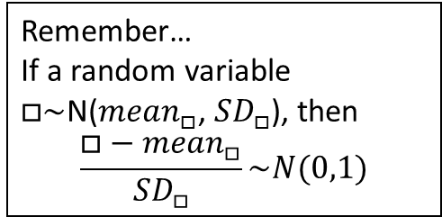
A housing survey was conducted to determine the price of a typical home in Topanga, CA. The mean price of a house was roughly $1.3 million with a standard deviation of $300,000. There were no houses listed below $600,000 but a few houses above $3 million.
What is the probability that the mean of 60 randomly chosen houses in Topanga is more than $1.4 million?
$$P(\overline{X}>1.4 mil)$$
Remember…
If a random variable $□\sim$N(${mean}_{□}$, ${SD}_{□}$), then
$$\frac{□−{mean}_{□}}{{SD}_{□}}\sim N(0,1)$$
21

Slide 84
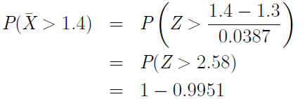
A housing survey was conducted to determine the price of a typical home in Topanga, CA. The mean price of a house was roughly $1.3 million with a standard deviation of $300,000. There were no houses listed below $600,000 but a few houses above $3 million.
What is the probability that the mean of 60 randomly chosen houses in Topanga is more than $1.4 million?
$$P(\overline{X}>1.4 mil)$$
Remember…
If a random variable $□\sim$N(${mean}_{□}$, ${SD}_{□}$), then
$$\frac{□−{mean}_{□}}{{SD}_{□}}\sim N(0,1)$$
Z-table
= 1 - P(Z ≤ 2.58)
21

Slide 85
Unit 3 – Confidence Intervals and Margin of Error

Slide 86
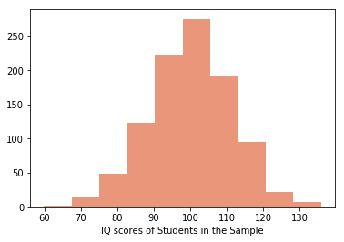
A random sample of IQ scores 13 high school students was collected with a mean of 110 points and standard deviation 11 points. The sample distribution is plotted below.
Clicker question
Can we create a 98% confidence interval using Central Limit Theorem methods?
yes
no
20

Slide 87
A random sample of IQ scores 13 high school students was collected with a mean of 110 points and standard deviation 11 points. The sample distribution is plotted below.
Clicker question
Can we create a 98% confidence interval using Central Limit Theorem methods?
Independence
✓ Random sampling
✓ n<10% of all high school students
Skewness/Sample Size
n>30? OR
We know σ and population is normal
yes
no
20

Slide 88
A random sample of IQ scores 13 high school students was collected with a mean of 110 points and standard deviation 11 points. The sample distribution is plotted below. Suppose we know that the population standard deviation is 15.
Clicker question
Can we create a 98% confidence interval using Central Limit Theorem methods?
yes
no
20

Slide 89
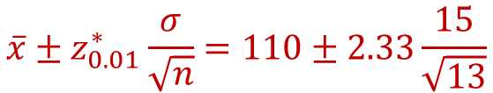
A random sample of IQ scores 13 high school students was collected with a mean of 110 points and standard deviation 11 points. The sample distribution is plotted below. Suppose we know that the population standard deviation is 15.
Clicker question
Can we create a 98% confidence interval using Central Limit Theorem methods?
Independence
✓ Random sampling
✓ n<10% of all high school students
Skewness/Sample Size
n>30? OR
We know σ and population is normal
yes
no
$$\overline{x}±z_{0.01}^{∗}\frac{σ}{\sqrt{n}}=110±2.33\frac{15}{\sqrt{13}}$$
20

Slide 90


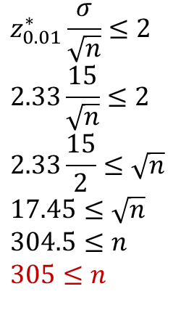
Suppose we know that the population standard deviation of high school IQ scores is 15 and the scores are normally distributed.
What minimum sample size do we need to create 98% confidence interval using Central Limit Theorem methods with margin of error of at most 2?
Know:
Solve:
$$ME=z_{0.01}^{∗}\frac{σ}{\sqrt{n}}$$
$$z_{0.01}^{∗}\frac{σ}{\sqrt{n}}≤2$$
$$2.33\frac{15}{\sqrt{n}}≤2$$
$$2.33\frac{15}{2}≤\sqrt{n}$$
$$17.45≤\sqrt{n}$$
$$304.5≤n$$
$$305≤n$$
$$ME≤2$$
20

